Slide 1


Github Collaborator Recommendation
Shan Zhong, Bill Wen, Albert Jian
Math 168 | Spring 2020 | Professor Heather

Slide 2
Introduction
This project aims to predict the probability of a link to recommend the highest probability links to a Github user.
Exploratory data analysis was conducted to further understand followers and following statistics
Binary classification method (Random Forest, Support Vector Machine and Gradient Boosting) was adopted to classify good links and bad links.
SVD was applied to reduce the dimension of the dataset.
Similarity measures such as jaccard distance, cosine distance and preferential attachment were calculated for featurization.
Ranking measures (page rank), centrality measures (katz centrality) and other metrics such as shortest path and common neighbors were also added for model training.
Confusion matrix was plotted at the end to evaluate model performance.

Slide 3
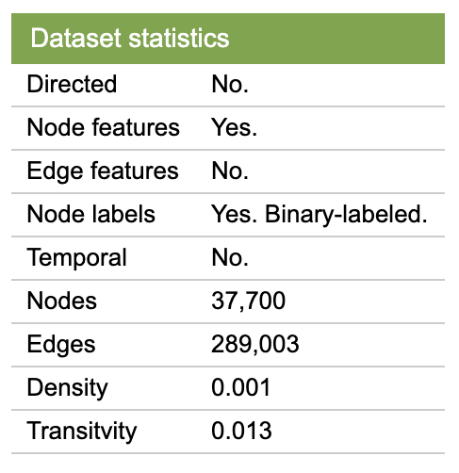
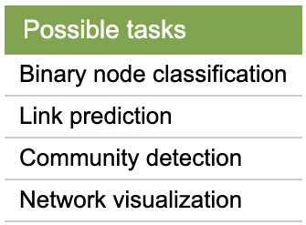
Dataset Information
Source: Stanford Large Network Dataset Collection
A large social network of GitHub developers which was collected from the public API in June 2019.
Nodes are developers who have starred at least 10 repositories and edges are mutual follower relationships between them. The vertex features are extracted based on the location, repositories starred, employer and e-mail address.

Slide 4
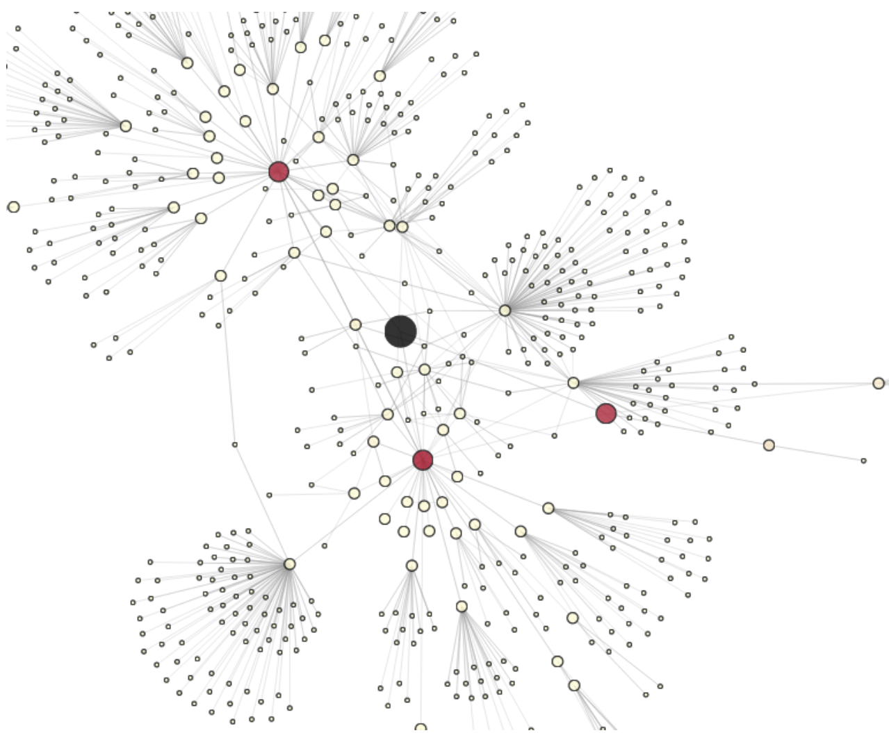
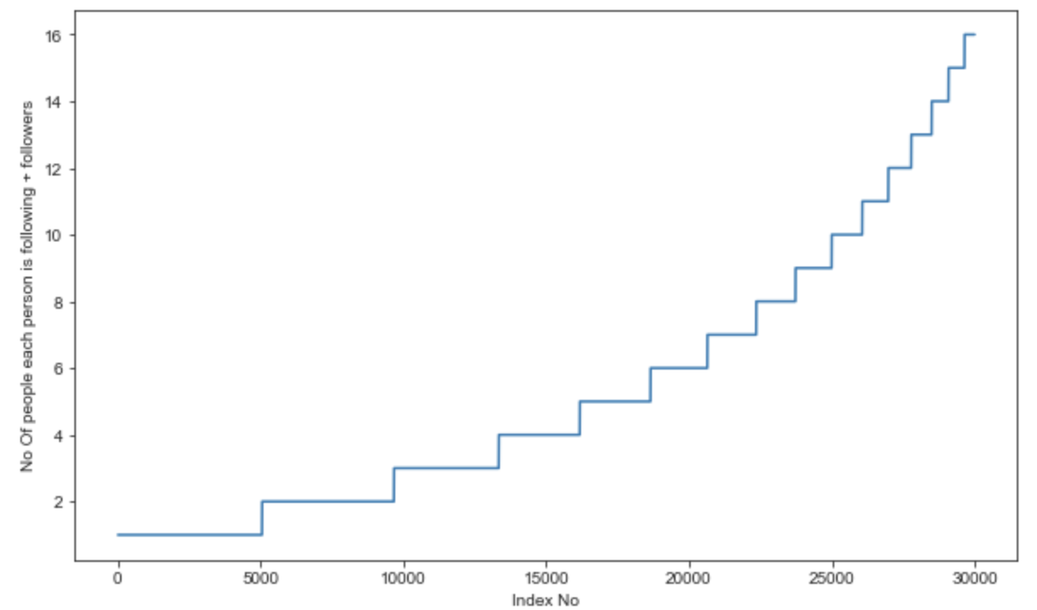
Exploratory Data Analysis
The largest number of followers and followees is 9458 and the minimum number of followers and followees is 1.
5045 people have minimum number of followers and followees. Number of people having followers and following less than 10 is 2499.
Notes:
The node in black is a selected node from the training set, and we perform a breadth-first walk of the graph out to a maximum distance of 3 to uncover the local network. Nodes are sized according to their distance from the center, and colored according to a chosen metric (a personalized PageRank in this case; more on this later).
We can see that the central node is friends with three other users (in red), two of whom have fairly large, disjoint networks.

Slide 5
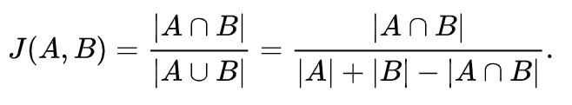
Featurizations
Jaccard Distance:
Assume that u1,u2,u3,u4,u5,u6 are connected,such that u1 followers-{u3,u4,u5} and u2 followers-{u3,u4,u6}.
We could find how dissimilar these two sets are using Jaccard distance.
The Jaccard similarity coefficient compares members for two sets to see which members are shared and which are distinct. It’s a measure of similarity for the two sets of data, with a range from 0% to 100%. The higher the percentage, the more similar the two populations. Although it’s easy to interpret, it is extremely sensitive to small samples sizes and may give erroneous results, especially with very small samples or data sets with missing observations.
Notes:
The node in black is a selected node from the training set, and we perform a breadth-first walk of the graph out to a maximum distance of 3 to uncover the local network. Nodes are sized according to their distance from the center, and colored according to a chosen metric (a personalized PageRank in this case; more on this later).
We can see that the central node is friends with three other users (in red), two of whom have fairly large, disjoint networks.

Slide 6
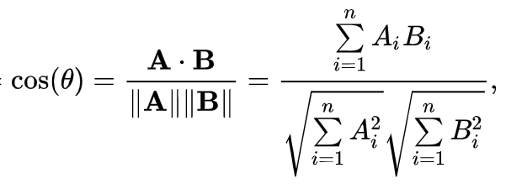
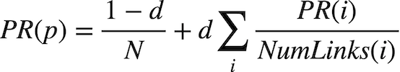
Featurizations
Cosine Distance:
Like Jaccard distance we could also calculate another distance which is an extension to cosine similarity.
PageRank:
Imagine whole internet as directed graph where each web page is node.
Each page is given a rank depending on number and quality/importance of links/edges.
It gives you a probability value for each of the web page that represents the likelihood of a random person clicking on a page to arrive at another page.
Notes:
The node in black is a selected node from the training set, and we perform a breadth-first walk of the graph out to a maximum distance of 3 to uncover the local network. Nodes are sized according to their distance from the center, and colored according to a chosen metric (a personalized PageRank in this case; more on this later).
We can see that the central node is friends with three other users (in red), two of whom have fairly large, disjoint networks.

Slide 7
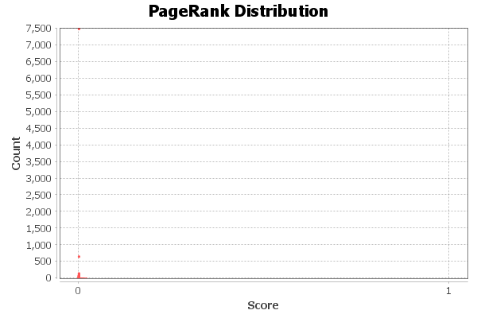
Notes:
The node in black is a selected node from the training set, and we perform a breadth-first walk of the graph out to a maximum distance of 3 to uncover the local network. Nodes are sized according to their distance from the center, and colored according to a chosen metric (a personalized PageRank in this case; more on this later).
We can see that the central node is friends with three other users (in red), two of whom have fairly large, disjoint networks.

Slide 8
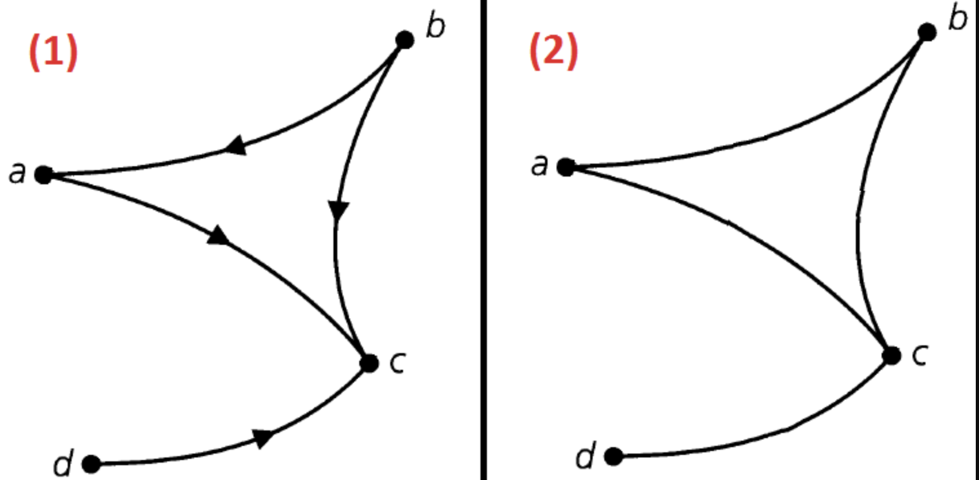
Featurizations
Shortest Path:
Getting Shortest path between two nodes, if nodes have an edge i.e, trivially connected then we are removing that edge and calculating the shortest path.
Else assign -1
Connected Component:
A digraph is strongly connected if for every pair of distinct vertices u and v there exists a directed path from u to v)
A digraph is weakly connected if for every pair of distinct vertices u and v there exists an undirected path (potentially running opposite the direction on an edge) from u to v.
Notes:
Diameter: 16
Average Path length: 3.7351540917066326
Number of Weakly Connected Components: 1
Number of Strongly Connected Components: 37700

Slide 9
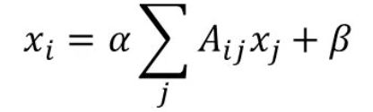
Featurizations
Katz Centrality:
Introduced by Leo Katz in 1953 and is used to measure the relative degree of influence of an actor (or node) within a social network.
Katz centrality similarly like page rank that measures influence by taking into account the total number of walks between a pair of nodes
SVD features:
We computed adjacency matrix
We then decomposed it using SVD of components 6 which results in two matrices left singular and right singular matrix.
Now both the matrices could be used as features containing vector of 6-dimensional
Notes:
The node in black is a selected node from the training set, and we perform a breadth-first walk of the graph out to a maximum distance of 3 to uncover the local network. Nodes are sized according to their distance from the center, and colored according to a chosen metric (a personalized PageRank in this case; more on this later).
We can see that the central node is friends with three other users (in red), two of whom have fairly large, disjoint networks.

Slide 10
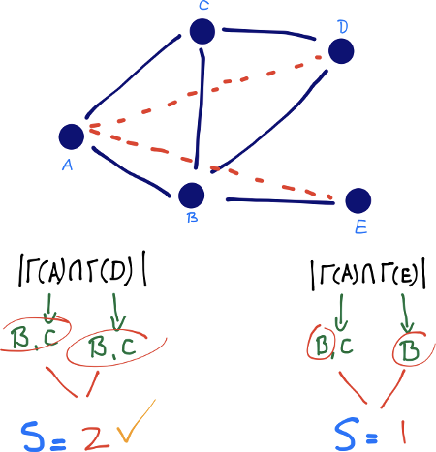
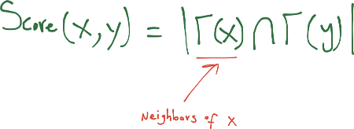
Featurizations
Common Neighbors:
Newman [7] has computed this quantity in the context of collaboration networks, verifying a positive correlation between the number of common neighbors of x and y at time t, and the probability that x and y will collaborate at some time after t.
list comparison : O(V . VlogV)
Notes:
The node in black is a selected node from the training set, and we perform a breadth-first walk of the graph out to a maximum distance of 3 to uncover the local network. Nodes are sized according to their distance from the center, and colored according to a chosen metric (a personalized PageRank in this case; more on this later).
We can see that the central node is friends with three other users (in red), two of whom have fairly large, disjoint networks.

Slide 11
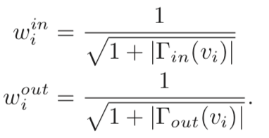
Featurizations
Weight feature:
Taken from a research paper - Graph-based Features for Supervised Link Prediction by William Cukierski, Benjamin Hamner, Bo Yang
Intuitively, consider one million people following a celebrity on a social network then chances are most of them never met each other or the celebrity. On the other hand, if a user has 30 contacts in his/her social network, the chances are higher that many of them know each other.
In order to determine the similarity of nodes, an edge weight value was calculated between nodes. Edge weight decreases as the neighbor count goes up.
Since the graph is directed,weighted in and weighted out are differently calculated:

Slide 12
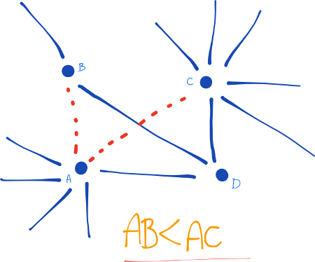

Featurizations
Preferential Attachment
One well-known concept in social networks is that users with many friends tend to create more connections in the future. This is due to the fact that in some social networks, like in finance, the rich get richer. We estimate how ”rich” our two vertices are by calculating the multiplication between the number of friends (|Γ(x)|) or followers each vertex has. It may be noted that the similarity index does not require any node neighbor information; therefore, this similarity index has the lowest computational complexity.
The link between A and C is more probable than the link between A and B as C have many more neighbors than B

Slide 13
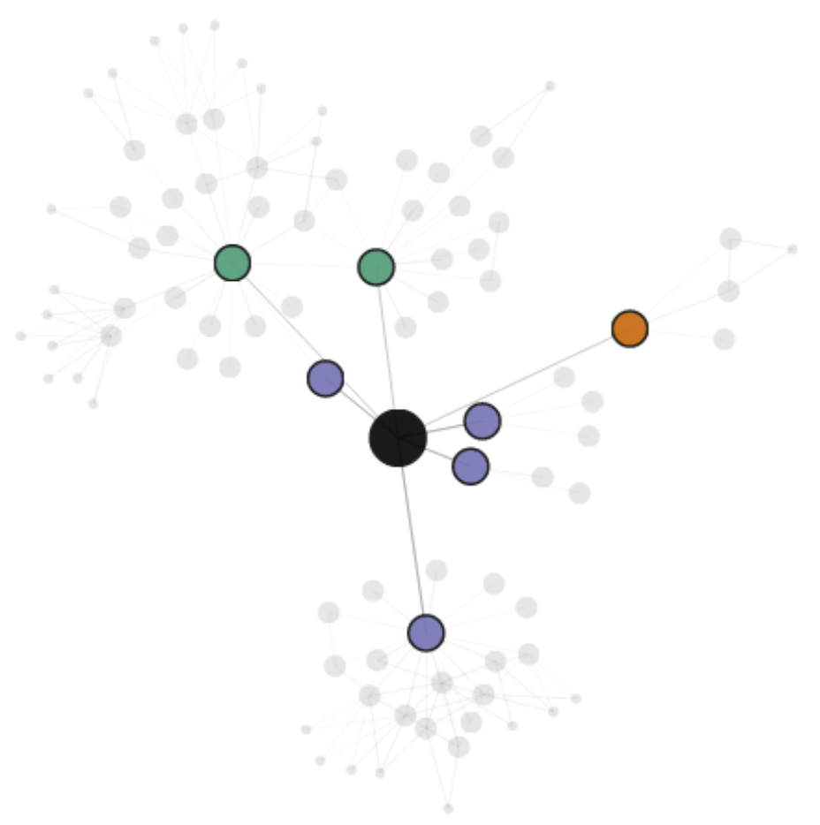
Feature Understanding
If we look at the following vs. follower relationships of the central node, we can see that, as expected (because edges that represented both following and follower were double-weighted in my PageRank calculation), the darkest red nodes are those that are friends with the central node, while those in a following-only or follower-only relationship have a lower score.

Slide 14
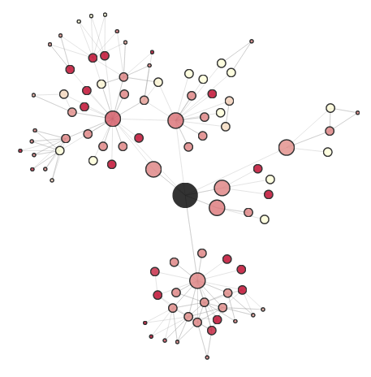
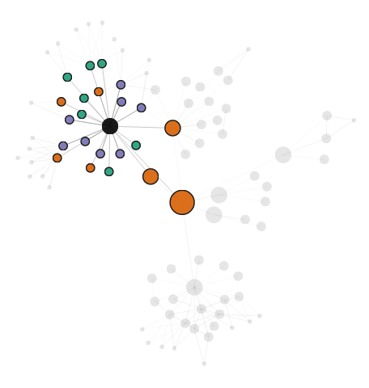
Feature Understanding
How does the propagation score compare to personalized PageRank?
Local network
Notes:
Here, I colored each node according to the log ratio of its propagation score and personalized PageRank:
Comparing this coloring with the local follow/follower network: we can see that followed nodes (in teal) receive a higher propagation weight than friend nodes (in purple), while follower nodes (in orange) receive almost no propagation score at all.

Slide 15
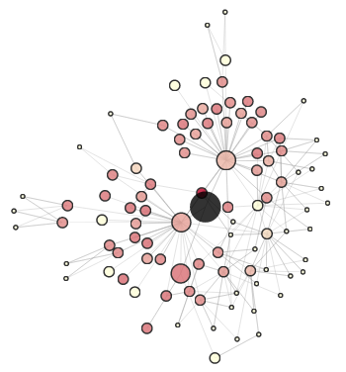
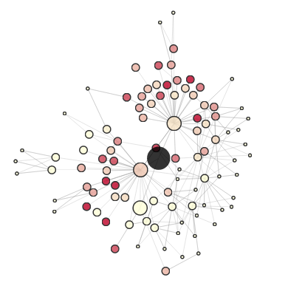
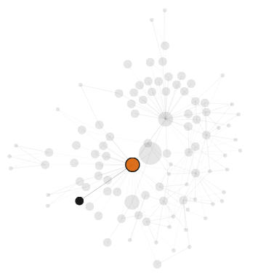
Feature Understanding
Here, each node is colored according to its Jaccard similarity with the source:
Regularized version of Jaccard similarity
Notes:
when nodes are represented by the set of their followers: We can see that, while the PageRank and propagation metrics tended to favor nodes close to the central node, the Jaccard similarity feature helps us explore nodes that are further out.
We can see that the outlier nodes are much more muted this time around.
However, if we look the high-scoring nodes more closely, we see that they often have only a single connection to the rest of the network: In other words, their high Jaccard similarity is due to the fact that they don’t have many connections to begin with. This suggests that some regularization or shrinking is in order.
So here’s a regularized version of Jaccard similarity, where we downweight nodes with few connections:

Slide 16
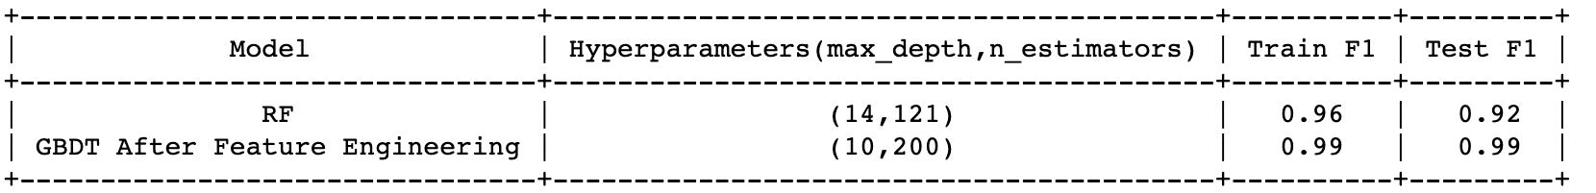
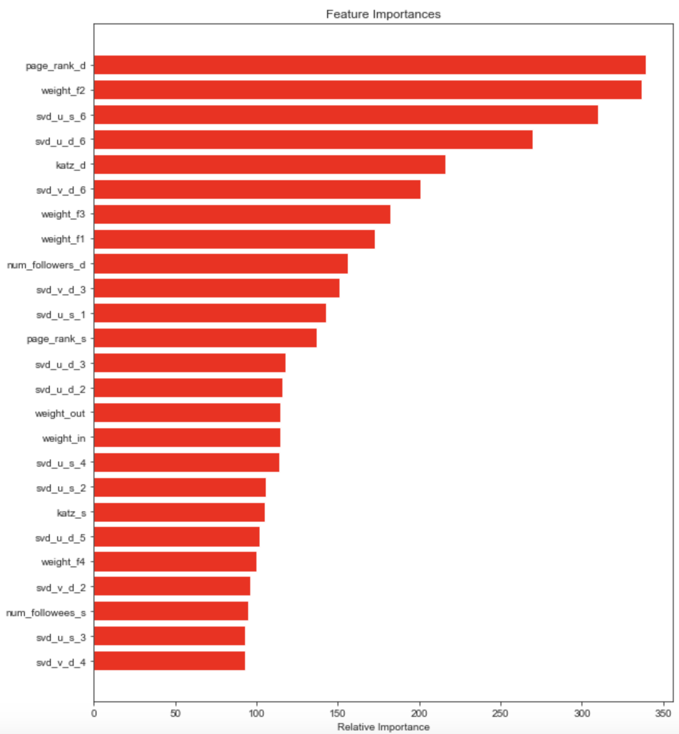
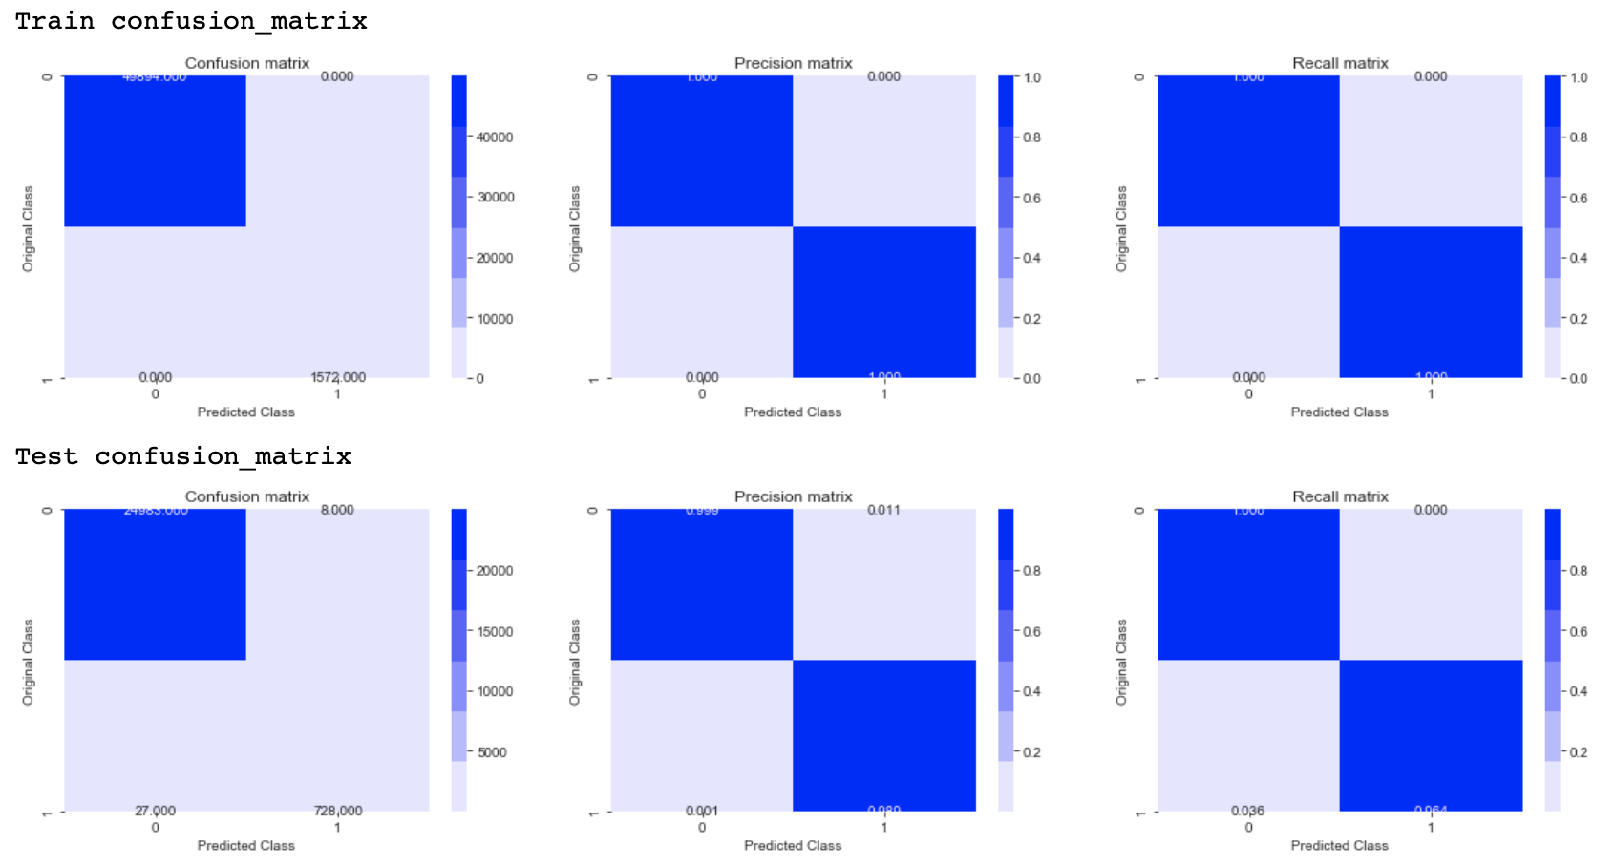
Results
Notes:
We can see that the most important variables are:
Personalized PageRank scores.
Whether the destination node already follows the source.
How similar the source node is to the people the destination node is following, when each node is represented as a set of followers. (Note that this is more or less measuring how likely the destination is to follow the source, which we already saw is a good predictor of whether the source is likely to follow the destination.) Plus several variations on this theme (e.g., how similar the destination node is to the source node’s followers, when each node is represented as a set of followees)

Slide 17
Thank you!

Slide 18
